Slide 1
A Brief History of Amyris Yeast Strain Engineering

Slide 2
In the beginning….
…there was nothing….
…and then….

Slide 3

..13.8 billion years ago, a rapid expansion of matter and energy known as The Big Bang
created the known Universe.

Slide 4
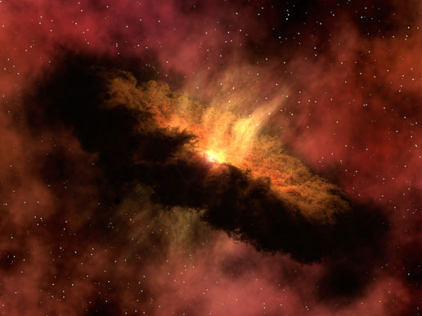
Approximately 9 billion years later, the heavy elements dispersed by a supernovae coalesced
by gravitational attraction to form the Sun and the rest of the Solar System.

Slide 5
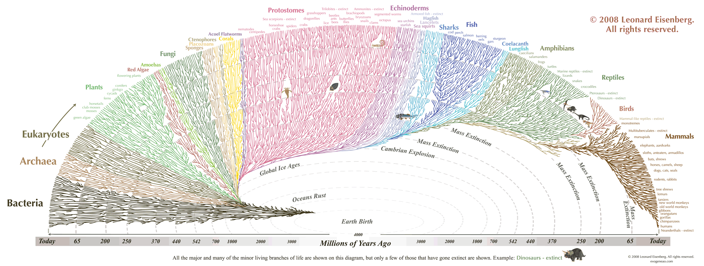
One billion years after that, a chemical reaction began on the third planet from the Sun
and is still continuing to this day.

Slide 6
Due to the principle of Natural Selection, this chemical reaction diversified into many different forms.
However, the underlying mechanism of this reaction (DNA) remains the same across the spectrum of Life.
This allows genetic engineers to take genes from one organism and express them in another.
genetic engineers to manipulate and combine elements

Slide 7
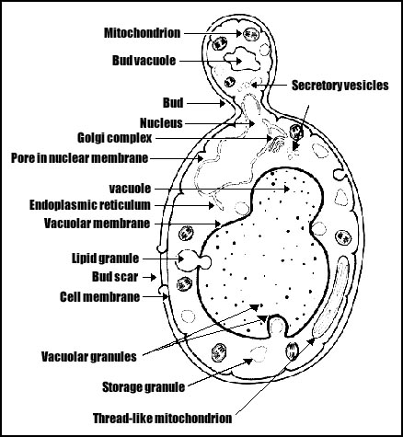
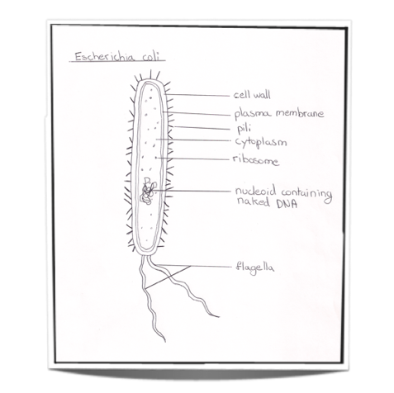
Synthetic Biology is conducted using laboratory tractable organisms.
1. Can be easily cultured in a lab.
2. Can be easily genetically modified.
Escherichia coli is the typically used prokaryotic lab tractable organism.
Saccharomyces cerevisiae is the typically used eukaryotic lab tractable organism.

Slide 8
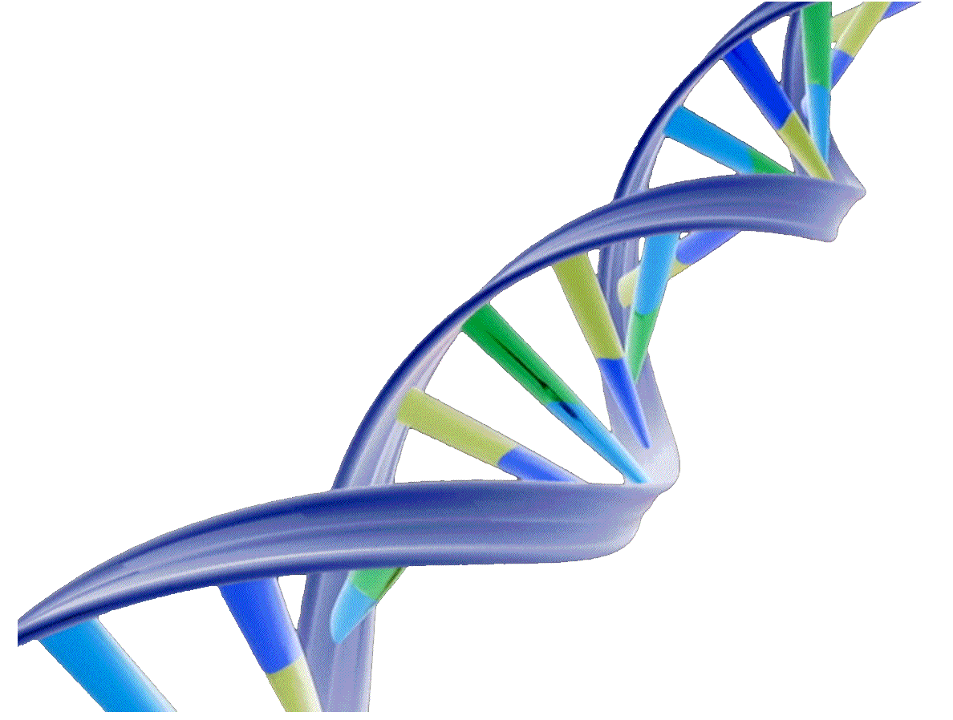
THE CENTRAL DOGMA
DNA → RNA → PROTEIN
Traditionally we control things at the transcriptional level.
Why? Because its easy, and most portable system.
How? Swap promoters. Change codon optimization.
We can also control things a the post-translational level.
Why? Potentially more powerful. Especially so for long lasting proteins.
How? Fusing a degradation tag to the protein. Temperature stability.

Slide 9
Definitions
Expression level: The amount of mRNA present for a given gene
mRNA: Messenger RNA. Created by transcription of DNA. Used during translation to create a protein.
Knock-Out: 1. (verb) To engineer the removal of a gene from the genome.
2. (noun) A strain in which a gene has been removed.
Knock-Down/Downregulate: To reduce the expression of a given gene
Upregulate: To increase the expression of a given gene
Integrate: To insert a DNA construct into the genome
Integration: The DNA construct being inserted into the genome.
Megastitch: A 2 part DNA construct made using ASE
Plasmid: Circular, artificial chromosome
Transformation: To alter a host’s genome by direct uptake of exogenously added DNA
URAloopout: To remove the URA3 marker from the genome.
Base pair: The singular unit of DNA. Made up of two complimentary nucleobases. Adenine-Thymine, Guanine-Cytosine
GTACTACTA
CATGATGAT
Codon: Three basepairs aligned in the open reading frame, coding for an amino acid.
Open Reading Frame: (ORF) The coding sequence of a gene. Including the start codon (ATG), and up until the stop codon.
Codon Optimized Gene : A gene with different codon usage coding for the same protein. May yield higher expression. Or worse.
Protein expression: There is no singular word for “total amount of a given protein” such as “expression” for mRNA. I think protein expression is our ad hoc way of describing it. Also total functional protein. Soluble fraction.

Slide 10
Definitions
Mutation: A basepair that differs from the original wild type sequence
Competition Assay: Used to assess the relative “synthase power” of an enzyme. Competes two enzymes for the same product. The ratio of the two products is a readout on their “synthase power”
Synthase Power: Protein Expression x Enzyme Kinetics. No one uses this term outside Amyris probably.
Galactose Regulon: Genetic regulation system for yeast galactose metabolism. We have the mevalonate pathway and many important genes under control of GAL regulon.
Lysine Switch: Strains produce terpenes in the absence of Lysine in the media.
Maltose Switch: Strains produce terpenes in the absence of Maltose in the media. Some maltose switch require 34C for ON state.
Transcription: The process of creating mRNA from DNA.
Translation: The process of creating a protein from mRNA
Promoter: Region ~1bp to 1000bp upstream of a gene. Includes regulatory sequences that control the expression of a gene.
Terminator: 1. Region ~1bp to 200bp downstream of a gene. Mediates transcriprtional termination and releases RNA polymerase.
2. Unstoppable killing machine sent from the future. Former Governor of California.
Transcription factor: A protein that binds to sequence in a promoter. Regulates gene expression.
PCR: Polymerase Chain Reaction. Method for amplifying a DNA segment.

Slide 11
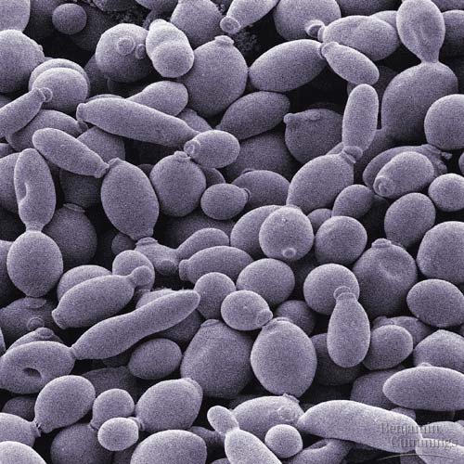
Yeast
Yeast is a eukaryotic unicellular microorganism classified into the kingdom Fungi
There are over 1,500 different yeast species. Our yeast is Saccharomyces cerevisiae
S. cerevisiae was one of the first domesticated organisms and has been used for fermentation for over 4000 years
Can exist in either a diploid or haploid state (our strains are mostly haploid)
Haploid cells can either be mating type a or α. (early strains are mostly a, current top strains are mostly α)
S. cerevisiae has 16 linear chromosomes comprising 2,156,677 basepairs and 6,275 genes, and was the first eukaryote to have its genome sequenced.
“The isogenic family of CEN.PK strains was developed by crossing of different laboratory strains of S. cerevisiae in the 1990's by a consortium of German yeast researchers. A subsequent multi-laboratory study in which four S. cerevisiae strains were compared, confirmed that the CEN.PK strains combine good accessibility to classical and molecular genetics techniques with excellent growth characteristics under controlled, industrially relevant conditions.”

Slide 12
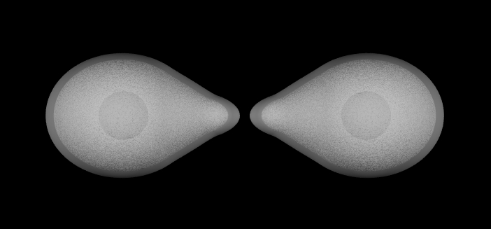
Yeast Genetics
Meiosis
Two haploid cells of opposite mating types will “shmoo” towards each other,
and combine genomes into a single diploid cell.
Sporulation of diploid lineage allows
A) independent segregation of chromosomes
B) recombination between paired chromosomes
The resulting population of haploid cells will have chromosomes from both “parents”.
This can be useful to create a library of cells containing mixed genomes or to reduce engineering cycle time.

Slide 13
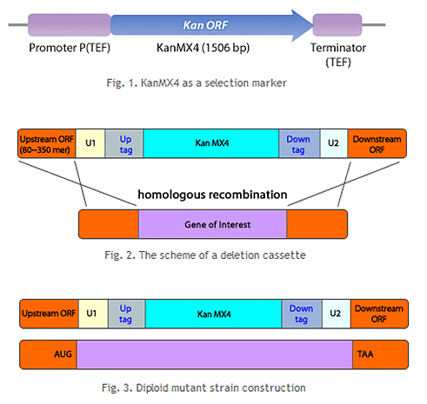
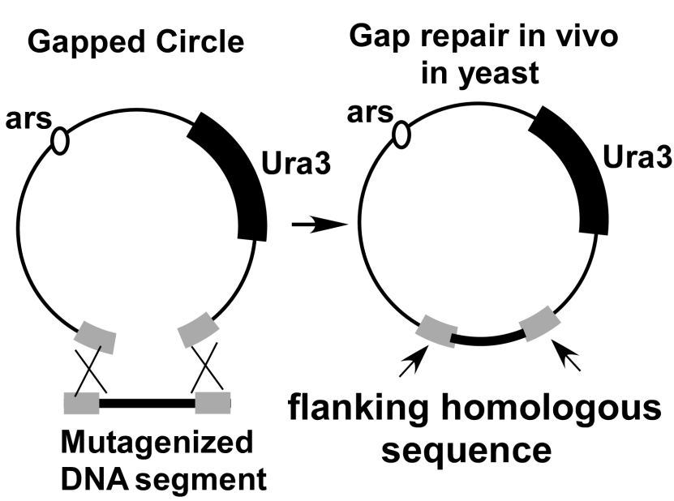
Yeast Genetics
Recombination
S. cerevisiae is remarkably efficient at DNA recombination repair
We utilize this quality in many ways.
CHROMOSOMAL INTEGRATIONS
GAP REPAIR CLONING

Slide 14
Yeast Genetics
Recombination
CHROMOSOMAL INTEGRATIONS
-Necessary for gene knock-outs or knockdowns
-Single copy expression (informative for direct enzyme comparisons)
-Very stable
-Most engineering done at Amyris are chromosomal integrations
-CRISPR allows multi locus markerless integrations by forcing double strand breaks at the desired locii
-Swappable strains utilize a different endonuclease to also force double strand breaks. These locii
however are pre-engineered with a recognized cut-site.
PLASMID SYSTEM
-Allows for easy multiple copy expression.
-However very unstable, will lose plasmid without constant selection.
-Easy to shuttle constructs into E.coli. E. coli is used as a bank for DNA. Grows faster, more copies.

Slide 15
Yeast Genetics
Tools of the Trade
HOW AUTOMATED STRAIN ENGINEERING WORKS
Polymerase Chain Reaction
A heat stable polymerase is utilized to amplify DNA segments
Short “primers” initiate extension, and define amplified segments
Cycling of temperatures amplifies DNA several orders of magnitude
In Vivo Recombination
DNA segments are jointly transformed into yeast
Combined into one construct by homologous recombination
Linker 0
US homology
Linker 2
Linker 2
Promoter
Linker A
Linker A
Gene
Linker 3
Linker 0
Linker 3
URA3LO P1
Linker 9
TRP
CENARS
Linker 9

Slide 16
Yeast Genetics
Tools of the Trade
HOW AUTOMATED STRAIN ENGINEERING WORKS
Linker 2
Promoter
Linker A
Gene
Linker 3
URA3LO P1
US homology
Linker 0
Linker 9
Assembled plasmid is selected by TRP marker.
This is one half of a “Megastitch”
TRP
CENARS

Slide 17
Yeast Genetics
Tools of the Trade
HOW AUTOMATED STRAIN ENGINEERING WORKS
Split URA marker ensures recombination of the two megastitches in order for +URA colonies to be obtained.
US homology
Megastitch A
URAlo 1
Megastitch A
Megastitch B
URAlo 2
Megastitch B
DS homology
US homology
Region to be replaced
DS homology
Megastitches are excised from plasmids using endonuclease to create two linear constructs
DS homology
MssI recognizes an 8 basepair sequence. Rare cutter. Unlikely to be in Megastitch.
US homology
Megastitch A
URAlo 1+ 2
Megastitch B
Recombination between repeats flanking URA marker increase chance for loss of URA marker.
Loss of URA3 can be selected for by use of 5-FOA. Loss of URA3 allows repeated use of same marker.
US homology
Megastitch A
Megastitch B
DS homology

Slide 18
Yeast Genetics
Tools of the Trade
CRISPR/Cas system
-Previous engineering relied on integrating megastitches 1 locus at a time, and marker recycling
-CRISPR evolved as an “adapative immunity” to viral DNA.
-With use of CRISPR can target almost any sequence of DNA with endonuclease, creating a double strand break
-Only by removal of targeting site with heterologus constructs can double streand break be repaired
-Allows multilocus simultaneous markerless engineering
-Allows small basepair editing without use of markers, “allele swaps”
Swappable Strains
-Prengineered loci contain target sites for endonuclease. F-cphI for X-cutter, and a Zfn for Y-cutter
-Functionally similar to CRISPR, except locii are predetermined.
-Used to swap out final synthases in the pathway, replace with “improved” versions in one step
-Swap in X-cutter constructs into Y-cutter locii.. and vice versa

Slide 19
The Mevalonate Pathway
The mevalonate pathway is present in all higher eukaryotes, S. cerevisiae included.
It produces DMAPP/IPP, 5 carbon building blocks which are used for the biosynthesis
of terpenoids, prenylated proteins, and steroids.
ERG10
ERG13
HMG1
Acetyl-CoA
thiolase
reductase
Mevalonate
DMAPP
IPP
FPP
ERG20
IDI1
ERG19
ERG8
ERG12
FPP synthase
isomerase
decarboxylase
P-mev kinase
mev kinase
ERG9
squalene synthase
Ergosterol

Slide 20
Our Mevalonate Pathway
tHMGR
ERG10
ERG13
ERG10
ERG13
HMG1
Acetyl-CoA
tHMGR
thiolase
reductase
Mevalonate
MS
Isoprene
Myrcene
Limonene
LS
GPPS
IS
ERG12
DMAPP
IPP
ERG20
IDI1
ERG19
ERG8
ERG12
FPP synthase
isomerase
decarboxylase
P-mev kinase
mev kinase
GGPPS
LDPPS
Sclareol
FPP
PS
Patchoulol
FS
Farnesene
ADS
Art. Acid
P450/CPR
ERG9
squalene synthase
Ergosterol

Slide 21
Our “GAL” Pathway
and the Switch to Switches
GAL3
In the presence of GALACTOSE
Gal3p binds Gal80p preventing
it from binding to Gal4p
Expression inhibited by presence of Glucose
GAL80
Gal80p binds Gal4p in the absence of GALACTOSE
preventing Gal4p from initiating transcription
GAL4
GAL4
activator
repressor
Pgal1
Gene of Interest

Slide 22
Our “GAL” Pathway
and the Switch to Switches
Constitutive Strains
Remove MIG1 binding site from GAL4 promoter to allow expression in presence of glucose
GAL3
GAL4
GAL80
Pgal1
Gene of Interest
2. Deleting GAL80 prevents it from
binding Gal4p in the absence of Galactose

Slide 23
Our “GAL” Pathway
and the Switch to Switches
Lysine Switch Strains
GAL3
1. Deleting GAL80 prevents it from
binding Gal4p in the absence of Galactose
Lysine
GAL80
GAL4
2. Placing GAL4 under the control of
the pLYS9 promoter suppresses transcription
in the presence of Lysine, and upregulates
transcription in the absence of Lysine.
Pgal1
Gene of Interest

Slide 24
Our “GAL” Pathway
and the Switch to Switches
Maltose Switch Strains
Remove MIG1 binding site from GAL4 promoter to allow expression in presence of glucose
Protein Degradation
Maltose
GAL4
GAL80
2. GAL80 is placed under control of
maltose inducible genes, such as Pmal32.
The presence of maltose increases transcription.
Pgal1
Gene of Interest
3. Mutant of GAL80 becomes unstable at 34C.
A constitutive degron is fused to N-terminal of GAL80
Penny created a MBP that makes GAL80 only stable in the presence of Maltose

Slide 25
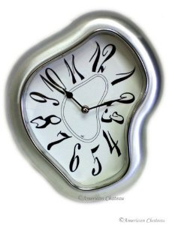
The History of the Early
Ys
Y227 -May 3, 2007-
CENPK strain development began essentially with this strain.
Created by crossing an a and α each with half the overexpressed MEV pathway. Sporulated, and
isolates found that had all the engineered locii.
Amorphadiene synthase from A. annua expressed from a leu2d plasmid.
Y677 -Feb 28, 2008-
The original farnesene producing base strain.
Major differences from Y227 include - PGAL4-OC/^gal80 making it a constitutive strain.
-leu2d Pgal1-FS from A. annua
Terribly, horribly, awfully unstable
Y1551 -Nov 4, 2008-
Mutagenesis enters the fray. First mutant hit. All previous strains were rationally engineered only.
YNG2 allele dramatically helps production. I think by increasing stability… but I could be wrong.
Y4352 -Apr 2, 2010-
First strain to lose Pam404. Replaced it with multiple integrated improved farnesene synthases.
Made strains more stable by reducing FPP accumulation, and loss of imposed leu2 starvation on population.
Y6831 -Mar 7, 2011-
First drug marker free strain. Useable in Brazil. All strains subsequently engineered with URA loopout.
…… and then onward to Second Gen strains!

Slide 26
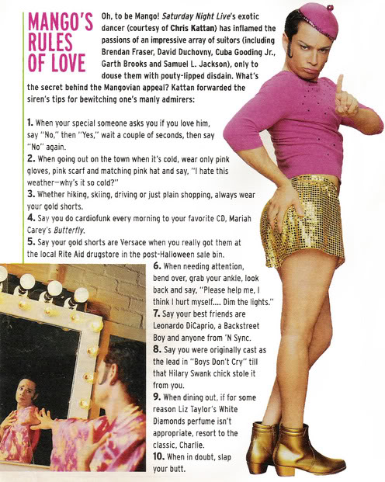
Project Mango
Enzymology Current Goals:
Find most functional Myrcene and GPP Synthases available.
How?
-Screening for production in an early nonmutangenized strain. Y13203.
-Switch is native galactose regulon system.
-Codon optimization can drastically increase expression level. Rare codons or mRNA folding can stall translation. No algorithm perfectly predicts this. We are trying two separate codon optimizations per synthase as a first pass.
Myrcene Synthases
-Use known reasonably functional AgGPPS2 for myrcene synthase screening
-Plasmid based system since we know the C10 synthase is most likely catalytically limiting and will need multiple copies.
-C10 synthases often have a plastid targeting sequence that make them
nonfunctional in yeast. Beginning and end of targeting sequence not clear.
-Followup is to compete myrcene synthases against limonene synthase. Ratio of two products is an estimate of their relative functionality.
-C10 synthases often have a plastid targeting sequence that make them nonfunctional in yeast. Beginning and end of targeting sequence not clear.
GPP Synthases
Use known reasonably functional ObMS on a leu2d plasmid.
Integrate single copy (2 single copies for heterodimers). Screen for production.

Slide 27
Project Mango
Strain Engineering Goals (in order of engineering)
In swappable strain background restore WT levels of ERG9
Swap in varying copies of AgGPPS2tr2 and ObMS.
This will give us an estimate on the flux capacity of each enzyme,
and give us our top producing lineage.
KO or titrate down the Pgal1-ERG20 . Potentially use estradiol switch.
Additional copies of synthases can be added to increase yield.
Swapping out original synthases for improved mutants.

